Slide 1

BMS INSTITUTE OF TECHNOLOGY AND MANAGEMENT
Avalahalli, Yelahanka, Bengaluru-560064 DEPARTMENT OF ELECTRONICS AND TELECOMMUNICATION ENGINEERING
Final year Technical Seminar (18TES84) Presentation
on
Development of a Penguin-Inspired Swimming Robot With Air Lubrication System
Under the guidance of:
Dr. SARITHA I G
Assistant Professor
Department of ETE
BMSIT &M
Submitted by:
S.VARSHA 1BY20ET048

Slide 2
CONTENTS
INTRODUCTION
LITERATURE SURVEY
MOTIVATION
OBJECTIVES
METHODOLOGY
RESULTS
APPLICATIONS
ENVIRONMENTAL SUSAINABILITY
SOCIETAL CONCERN
CONCLUSION
REFERENCES

Slide 3
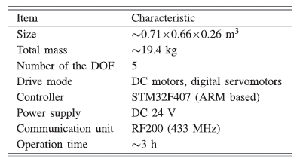
INTRODUCTION
Mimics the agile movements of biological penguins
Two degrees of freedom (DOF) wings to achieve flexible planar movement
Heaving
Pitching
Buoyancy-driven system for ascending and diving
Air lubrication system inspired by the BDR phenomenon of penguins jumping out of the water
Table 1: Technical Parameters

Slide 4
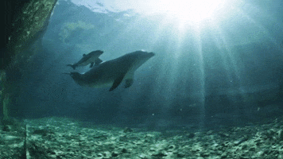
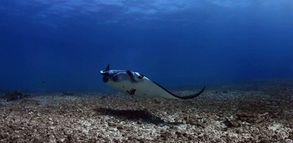
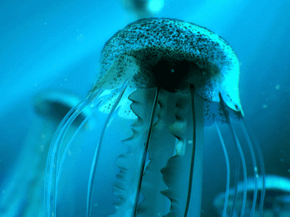
WHY AQUATIC ANIMALS?
Aquatic animals possess superior propulsion characteristics
including:
High Efficiency
Low Noise
Excellent Maneuverability
Motion Mechanism
Body and/or Caudal Fin (BCF) Mode
Flexible Body
Dolphin
Median and/or Paired Fin (MPF) Mode
Pairs Of Powerful Wings
Manta
Jet Propulsion Mode
Jellyfish

Slide 5
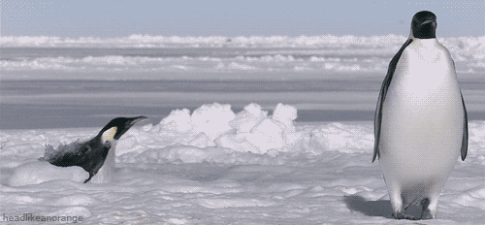
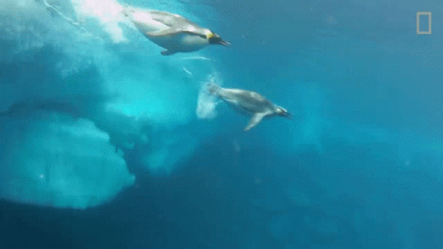
WHY PENGUINS?
Adapted to underwater swimming
Utilizes the burst swimming strategy of hydrofoil like wings
Mechanism of penguins jumping out of the water onto the ice
Dive with compressive air in their wings
Release during ascending
Expanding microbubbles form a smooth lubrication coat
over the body
Making it swim twice as fast as normal
Bubble drag reduction (BDR)

Slide 6
LITERATURE SURVEY
TITLE | YEAR | AUTHOR | PUBLICATION | METHODOLOGY
Toward a novel robotic manta with unique pectoral fins | 2022 | Y. Meng, Z. Wu, H. Dong, J. Wang, J. Yu | IEEE Transactions on Systems, Man, and Cybernetics: Systems | Improved crank rocker mechanism endows the robot with high swimming speed and efficient flapping patterns. Distinctive horizontal DOF is employed to coordinate with the flapping movement, allowing remarkable pitch adjustment.

Slide 7
LITERATURE SURVEY
TITLE | YEAR | AUTHOR | PUBLICATION | METHODOLOGY
Biomimetic Realization of a Robotic Penguin Wing: Design and Thrust Characteristics | 2021 | Y.Shen, N.Harada, S. Katagiri, H.Tanaka | IEEE/ASME Transactions on Mechatronics | Flapping motion generates the main thrust during locomotion. Pitch angle can change the thrust direction. Feathering motion enables active control of the angle of attack. Stalling of the wing occurs near an AoA of 10◦ in the steady state. The feathering motion can avoid the stall, boost the net thrust and reduce the torque required to actuate the flapping motion.

Slide 8
LITERATURE SURVEY
TITLE | YEAR | AUTHOR | PUBLICATION | METHODOLOGY
Motion Control Strategies for a Repetitive Leaping Robotic Dolphin | 2019 | J.Yu , Z.Wu , Z.Su, T.Wang , S.Qi | IEEE/ASME Transactions on Mechatronics | An integrative model that takes account of both kinematics and dynamics is established to explore the possibility of leaping with an untethered swimming robot. A high-speed swimming control strategy is put forward based on the angle of attack theory, followed by the proposal of orientation control strategy.

Slide 9
LITERATURE SURVEY
TITLE | YEAR | AUTHOR | PUBLICATION | METHODOLOGY
From natural complexity to biomimetic simplification: The realization of bionic fish inspired by the cownose ray | 2019 | Y. Cai, S. Bi, G. Li, H.P.Hildre, H.Zhang | IEEE Robotics & Automation Magazine | Low flapping frequency and flexible surface bring low hydrodynamic noise capability. Pivot turning and roll swimming improves maneuverability. The complex movement deformation of the cownose ray is split into two main components: chordwise wave transmissions and spanwise flapping movements.

Slide 10
LITERATURE SURVEY
TITLE | YEAR | AUTHOR | PUBLICATION | METHODOLOGY
Thrust force characterization of free-swimming soft robotic jellyfish | 2018 | Jennifer, Nick, Curet, Erik, Engeberg | Bioinspiration & Biomimetics | Unique soft robotic jellyfsh with eight pneumatic network tentacle actuators extending radially from their centers. Manufactured with a different composition of body and tentacle actuator Shore hardness. Actuator material Shore hardness, actuation frequency, and tentacle stroke actuation amplitude significantly impacted mean thrust force generation.

Slide 11
MOTIVATION
Robots are fascinating human inventions that are capable of carrying out a complex series of actions automatically.
Being an interdisciplinary field, it helps to analyze the use of electronics practically in a different field.
Helps in learning the latest innovative technologies.

Slide 12
OBJECTIVES
To understand the mechatronic design of the robot
To analyze the underwater movement generation capability of the robot
To understand the process of designing innovations through biomimicry

Slide 13
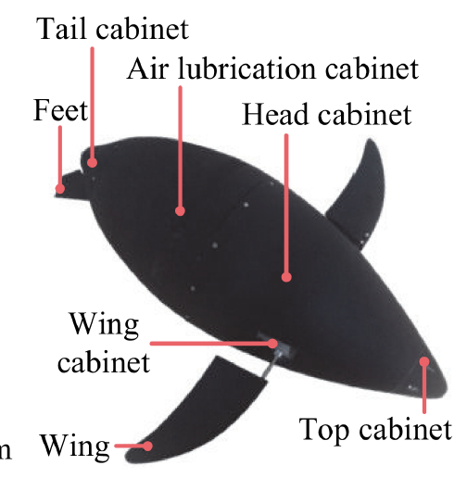
METHODOLOGY
MECHATRONIC DESIGN OF THE ROBOTIC PENGUIN
Biomimetic Robotic Penguin Design
Well-streamlined body for better hydrodynamic performance
Divided into four parts
Head cabinet containing a buoyancy-driven system
Pair of wing outer cabinets
Air lubrication cabinet
Tail cabinet with a pair of feet
Figure 1: Robotic prototype

Slide 14
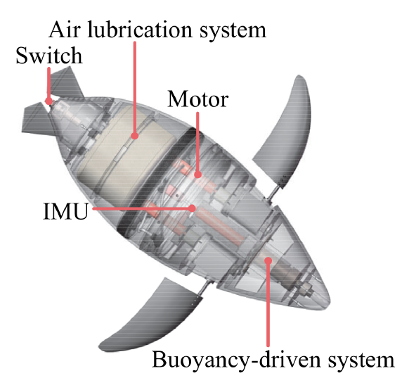
Wings: 2-DOF movement capability
Heaving motion
Direct current (dc) motor
Pitching motion
Digital servomotor
Buoyancy-driven System to realize ascending and diving
motion
Water Injector
Piston
Designed with almost complete symmetry
Unique Air Lubrication System with a maximum pressure of 3 MPa
Figure 2: Conceptual design

Slide 15
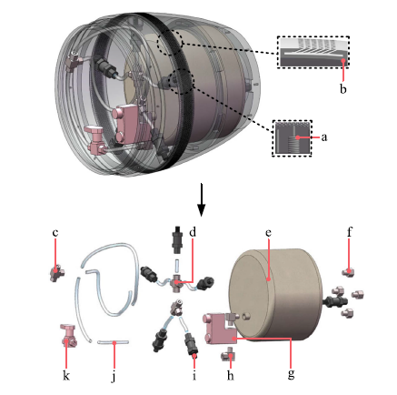
2. Construction of the Air Lubrication System
Main Principle
To generate stable bubbles around the body through spraying air reducing skin friction and increasing speed
Designed near the largest cross-section of the middle and rear part
Divided into three parts
1) Compressed Gas Cylinder (e)
Figure 3: Air Lubrication System

Slide 16
2) Air Control Unit
Solenoid Valve (g)
Tee Fittings (c)
Cross Fittings (d)
Right Angle Adapters (h)
Polyamide (PA) Pipe (j)
Flow Valve (k)
One-way Valves (i)
3) Cabinet Shell
Screwed Joint (a)
Inclined Hole (b)
Cavity (b)
Figure 3: Air Lubrication System

Slide 17
Operation of the Air Lubrication System
Divided into two stages
Air Storage Stage
Needs an air compressor to pump compressed air into the cylinder.
To avoid air leakage, a one-way valve connects the compressed gas cylinder with air compressor.
Figure 3: Air Lubrication System

Slide 18
2. Air Releasing Stage
Microcontroller unit (MCU) sends an opening signal to the solenoid valve.
Pipeline is turned on.
Compressed air in the compressed gas cylinder is delivered to the five outlets through the air control unit.
Air transits through the cavity and released from the inclined hole.
By sending a closing signal through the MCU, the pipeline will be closed immediately.
Figure 3: Air Lubrication System

Slide 19
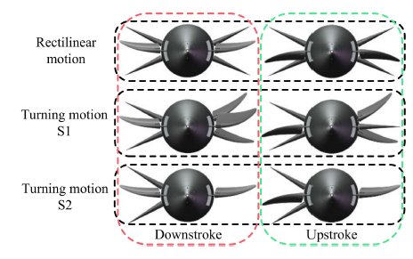
BASIC MOTION STRATEGY
Turning Schemes
(S1): Both sides of the wing maintain the rectilinear mode, one side rotates δ_{θ}, turning motion is realized by the difference in thrust on both sides.
(S2): The wing on one side rotates δ_{θ} to remain motionless, and the other side maintains the rectilinear mode to realize turning motion.
Figure 5: Schematics of motion strategy

Slide 20
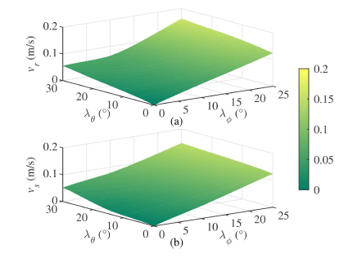
RESULTS
Systematic tests conducted in a 5 × 4 × 1.5 m experimental tank.
Rectilinear Motion
Relationship between forward speed and:
Motion frequency (f)
Pitching amplitude (A_{p})
Heaving amplitude (A_{h})
With the increase of f, A_{p}, A_{h} the forward speed is
faster within the range of the parameters.
Maximum stable speed = 0.567 m/s
when ν = 2.0 Hz, λ_{φ} = 25◦, and λ_{θ} = 30◦
Figure 6: Comparison of forward speed for different λ_{φ} and λ_{θ} at
ν = 0.5 Hz
(a) Experimental results
(b) Simulated results

Slide 21
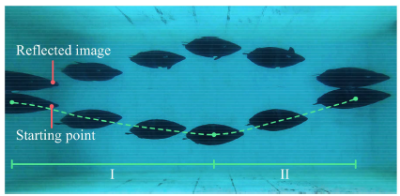
2. Vertical Motion
Maximum displacement of the piston = 0.07 m
Yield net buoyancy range = 0.242 N
Maximum stable vertical velocity of ascending = 0.03 m/s
Maximum stable vertical velocity of diving = 0.06 m/s
Figure 7: Robotic penguin during ascending and diving motion

Slide 22
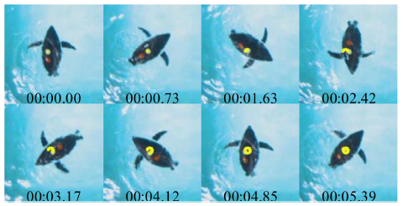
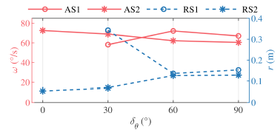
3. Turning Motion
Two main indicators:
Angular Velocity ω (red block)
Turning Radius r (yellow block)
Maximum angular velocity by S1 = 72.155 ◦ /s (δ_{θ} = 60◦, r = 0.14 m)
Maximum angular velocity by S2 = 72.605◦/s (δ_{θ} = 0◦, r = 0.06 m)
Figure 8: Turning motion with S2
Figure 9: Comparison of different turning strategies

Slide 23
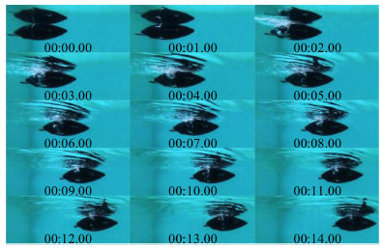
3. Performance of Air Lubrication System
Air Lubrication System process divided into three periods:
Development Period: Period of bubbles from zero to abundance
Duration Period:
Bubbles are attached to the surface and
constantly replaced by new ones
Significant acceleration stage
Decline Period:
Long-lasting recession period, when the pressure of the residual air is difficult to maintain the lubrication layer at the current speed.
Figure 10: Robotic penguin
during air lubrication

Slide 24
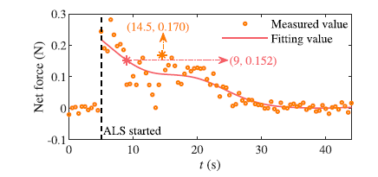
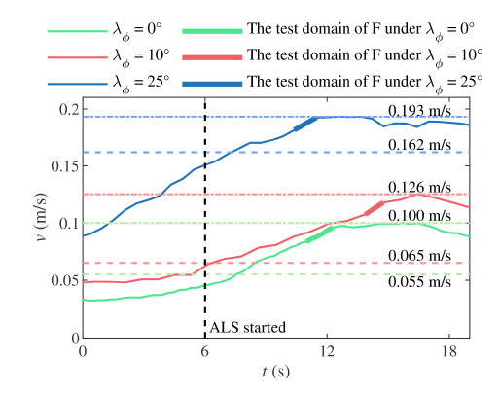
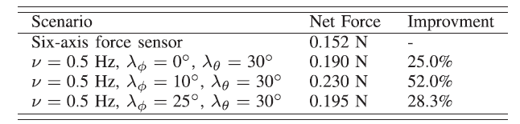
Figure 12: Thrust of the six-axis force sensor results in a static state with air lubrication
Figure 11: Experimental results of the forward speed for different λ_{φ} at ν = 0.5 Hz and λ_{θ} = 30◦ with air lubrication system
Table 2: Comparison of net force for different scenarios

Slide 25
APPLICATIONS
Marine Science and Research
Underwater Archaeology
Ocean Exploration
Military and defence applications
Underwater Infrastructure Inspection and Maintenance
Search and rescue operations
Offshore Oil and Gas Industry
Environmental Monitoring and Pollution Detection
Underwater Transportation

Slide 26
SOCIETAL CONCERN
Environmental Impact
Underwater Noise Pollution
Impact on Traditional Industries
Privacy and Security
Resource Exploitation
Navigation and Collision Risks
Technological Dependence
Data Security and Integrity

Slide 27
CONCLUSION
Compared with the existing MPF-driven swimming robot, the robotic penguin designed achieves an average speed level and has higher steering flexibility.
The air lubrication system has been proved to be effective in improving the speed of the robotic penguin and can be used as an auxiliary means to enhance the performance of swimming robot in the future.
There is a big gap between the developed robotic penguin and the biological penguins, but the study of the bionic robotic penguin can advance the exploration of the penguin motion mode.

Slide 28
REFERENCES
[1] J. Wang, Z. Wu, M. Tan, and J. Yu, “3-D path planning with multiple motions for a gliding robotic dolphin”, IEEE Transactions on Systems, Man, and Cybernetics: Systems, May 2021
[2] Y. Meng, Z. Wu, H. Dong, J. Wang, and J. Yu, “Toward a novel robotic manta with unique pectoral fins”, IEEE Transactions on Systems, Man, and Cybernetics: Systems, March 2022
[3] S. Sindagi and R. Vijayakumar, “Succinct review of MBDR/BDR technique in reducing ships drag”, Ships Offshore Structure, 2021
[4] Y. Shen, N. Harada, S. Katagiri, and H. Tanaka, “Biomimetic realization of a robotic penguin wing: Design and thrust characteristics,” IEEE/ASME Transactions on Mechatronics, October 2021
[5] W. Stoll, “Aquapenguin,” FESTO, Esslingen, Germany, Tech. Rep. 54711/EN, 2009
[6]Y. Shen, N. Harada, S. Katagiri, and H. Tanaka, “Biomimetic realization of a robotic penguin wing: Design and thrust characteristics,” IEEE/ASME Trans. Mechatronics, October 2021
[7] Y. Cai, S. Bi, G. Li, H. P. Hildre, and H. Zhang, “From natural complexity to biomimetic simplification: The realization of bionic fish inspired by the cownose ray,” IEEE Robotics and Automation, September 2019

Slide 29
Thank You

